Slide 1
SPN Architecture
128

Slide 2
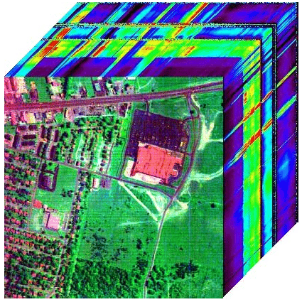
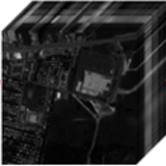
1. Single Attention
Conv 3D
Conv 3D
Conv 3D
Attention Layer
Conv 2D
DropOut
DropOut
DropBlock 3D
DropBlock 3D
DropBlock 3D
Hyperspectral
Dataset
Cube
Patches
8 @ 3 x 3 x 7
16 @ 3 x 3 x 7
32 @ 3 x 3 x 7
64 @ 3 x 3
Flatten
256
128

Slide 3
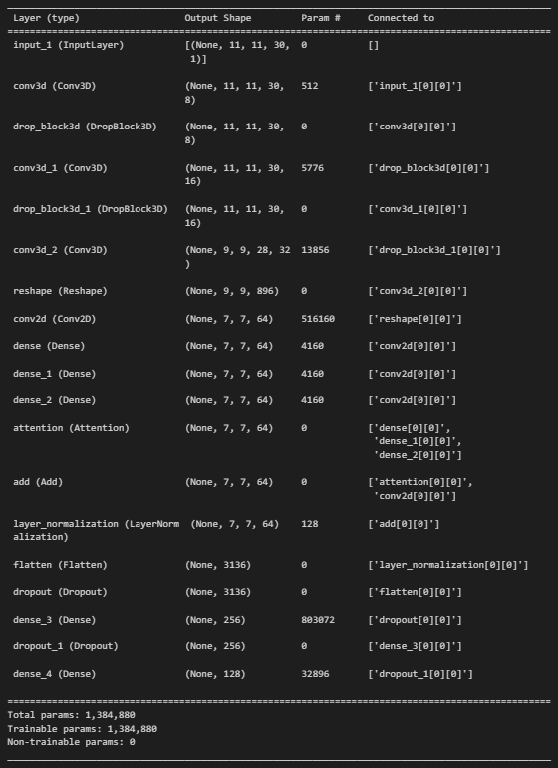

Slide 4
2. Single Multi-Head Attention
Conv 3D
Conv 3D
Conv 3D
Conv 2D
Self Attention Layer
DropOut
DropOut
DropBlock 3D
DropBlock 3D
Hyperspectral
Dataset
Cube
Patches
8 @ 3 x 3 x 7
16 @ 3 x 3 x 7
32 @ 3 x 3 x 7
64 @ 3 x 3
Flatten
256
128

Slide 5
3. SAB and CAB

Slide 6
Conv 3D
DropBlock 3D
Conv 3D
DropBlock 3D
Conv 3D
Hyperspectral
Dataset
Cube
Patches
8 @ 3 x 3 x 7
16 @ 3 x 3 x 7
32 @ 3 x 3 x 7
Self Attention
Conv 2D
N
DropOut
DropOut
CAB
Conv 2D
Self Attention
Flatten
256
128
SAB
Concatenation Attention
Element-wise Addition
Cross Attention
N
Layer Normalization
SAB - Self Attention Block CAB - Cross Attention Block

Slide 7
